Slide 1
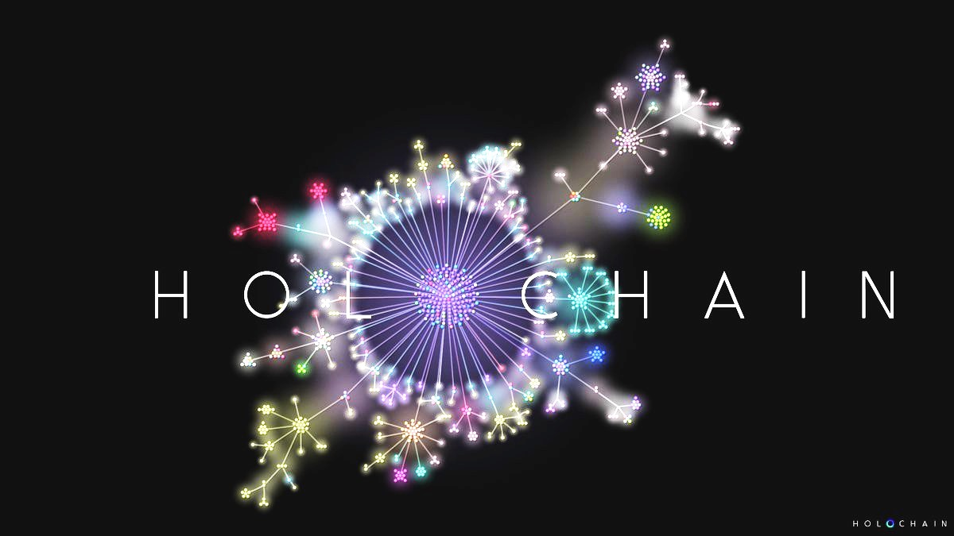
Intro presentation
Momir Dragišić
05.12.2018.
Upbeat forum, Podgorica

Slide 2
At the beginning, there was Internet
Basic http protocol – aimed for scientists to exchange data, share libraries
Originally, very primitive and static purpose
But, it is the new kind of collective intelligence foundation.

Slide 3
And then, 2.0 version came
The same simple protocol, new ideas and needs evolve
>>>It is becoming «social», concept of P2P…
But, is it the true now, when we see how has it been developed?
(more like peer-to-monopoly-to-peer)

Slide 4
And what does it mean?
!!! We are using outdated, expensive and inappropriate technology. And we let it to govern the huge part of our lives. More and more every day…
And this is not all :) It makes us more depressive, addicted and it generally has very doubtable consequences on the quality of our lives.
Regardless the obvious benefits, the overall impact is not so positive:
Depression and alienation
Environmental footprint
(more scientific confirmations coming every day)

Slide 5
And what does it mean?
Our collective intelligence is begging for a better home :)

Slide 6
So, Holochain is…
Many things:
Agent based platform with new kind of IT development standard and set of new kind of protocols – answering the need for real P2P environment, truly distributed
Environment for distributed apps development, of any type – no admin, special model of voluntary social coherence
Holo.host as 1st, master app to distribute data, the bridge between daps and plain old Internet browser (no wallets?)
And much more…

Slide 7
So, Holochain is…
A new home for the new kind of collective intelligence, developed through last 20 years of intensive and massive social P2M2P interactions.
A RECIPE TO REPAIR INTERENT 2.0, PIECE BY PIECE. To serve our new needs the way we want :)

Slide 8
Again, why do we need this?
Old system is stacked in closed circle, it is haunting its own tale. The development potential is supposed to stay infinite, continuous growth till the end of times!?! And the capacities are limited. So, tricks and addiction development is the only way. The cost is payed by users.

Slide 9
Again, why do we need this?
IT sector is just a reflection of overall economy model. The money is behind it, as it is in any other «industry».
But, the money DOES NOT ALLOW development of new and emerging, Holodial collective intelligence. It just supports only creation of Pyramidal one.

Slide 10
Again, why do we need this?
Do you see the paradox now?

Slide 11
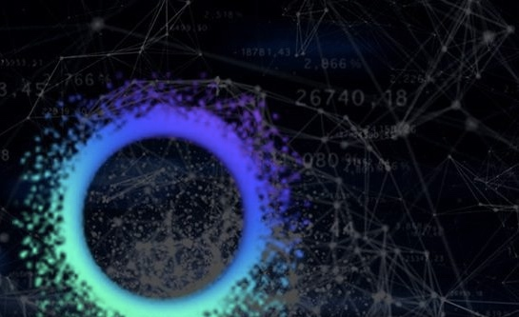
Complete solution
Integrally designed ecosystem to operate together the better way. To create the better economy foundations, that allow us to exchange values freely, but also incentivizes us to create and share values also.
Environment where NEW, BETTER US can grow and interact in regenerative way (not only sustainable!?!), become even better version of ourselves, individually and collectively.

Slide 12
Complete solution
The practical way to «hack ourselves» and prepare for the Post-monetary world that is coming. (hope no doubts it is to come, probably soon, one way or the other…)
Blockchain has marked the beginning of this process, proving that transactions can be done the new, distributed way (no middleman).
But, are there some players generating power and influence in the middle actually, like miners?
Is this solution the one that is complete?

Slide 13
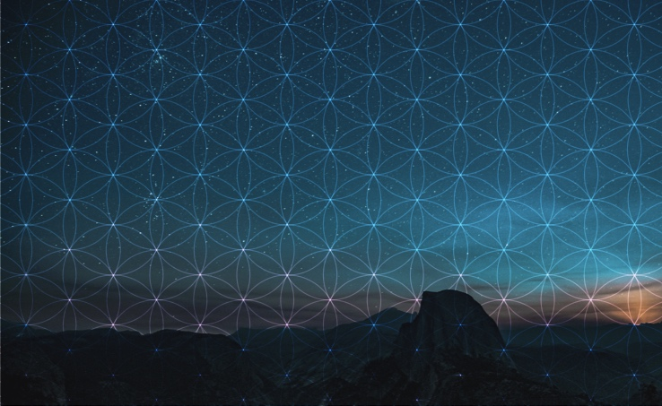
Getting back the original intelligence…
Total distribution of power (vs. centralization)
Labor integration (vs. division)
Open-minded but responsible mindset (vs. strict chain of command)
+
!!!Infinite currency (vs. scarce version called Money)
…ending the monopoly game driven by Pareto effect (the rich get more rich)

Slide 14
The data integrity…
There is encryption, at the agent level (no central ledger/chain!!!)
There are notaries, that cruise and check
Gossiping also, for the overall system resilience
DNA, cells, tissue… Immune system, membranes…
No mumbo-jumbo, just a carefully designed fresh start based on technology architecture that fits those new, evolved needs.

Slide 15
Where is the coin (HOT) here?
No coin actually, just a MUTUAL CREDITS system, cryptographically signed…
!!!The currency is able to go + and –, according to agreed rules (reputation for example, IMPACT also?)
Connected to basic function of hosting Dapps and serving their content users through web browser. (new generation of cloud computing!!!)

Slide 16
A final word…
Our question is not how to create new bitcoin, but much more ambitious (and needed btw), like HOW TO REPAIR THE WORLD? Eliminating corruption, incompetence… Handling complexity… Building resilience and adaptive capacities…
The practical answer: How to become able to learn again? How to stop hurting ourselves?

Slide 17
A final word…
(It is not going to be made by pure intent, but by applying the adequate ARCHITECTURE…)
Let’s build the right home for our (beloved) Internet 2.0, with true P2P protocols and systems behind!
Are you in?

Slide 18
Thank you!

